Slide 1
Election of 1860 and Secession

Slide 2
I. America in 1859
A. President was James Buchannan
1. He refused to address slavery issue
2. Pennsylvanian with Southern sympathies
B. Supreme Court continued to protect slavery and the fugitive slave laws
C. John Brown leads a raid on Harpers Ferry reigniting the slavery debate
1. Southerners view this as treason
2. Northerners view him as a hero (in some cases)

Slide 3
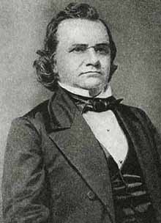
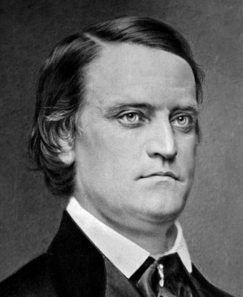
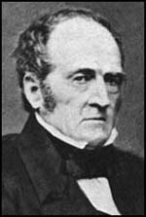
Candidates
Abraham Lincoln
Republican
Stephen Douglas
Democrat - North
John Breckenridge
Democrat - South
John Bell
Constitutional Union

Slide 4
II. Nominating Conventions of 1860
A. Democratic Party splits
1. Met first in South Carolina with Douglas as leading candidate of northern wing
a. Southern "fire-eaters" regarded him as a traitor for his position on Lecompton and Freeport Doctrine and eight cotton states walked out of the convention.
2. Next convention in Baltimore nominated Douglas while the Democratic party split in two
a. Platform: popular sovereignty and against obstruction of Fugitive Slave Law by the states.
b. Again, many cotton-state delegates walked out and organized a rival convention in Baltimore where many northern states were unrepresented.
3. Southern Democratic party nominate John C. Breckinridge
a. A moderate from Kentucky, not a disunionist
b. Platform: extension of slavery into territories and annexation of Cuba

Slide 5
Northern Democrats
popular sovereignty
against obstruction of the Fugitive Slave Law by the states.

Slide 6
Southern democrats
extension of slavery to the west
annexation of Cuba

Slide 7
B. Constitutional Union Party
1. Nominate John Bell of Tennessee
a. Wanted to preserve the Union; saw Bell as a compromise candidate.
b. Consisted of former Whigs from the upper South and Know-Nothings c. Feared that a Lincoln victory would cause Deep South states to secede

Slide 8
Constitutional union party
wanted to preserve the Union
follow the guidelines in the Constitution

Slide 9
C. Republican Party
1. Nominate Abraham Lincoln of Illinois (believed he was more electable then others)
2. William H. Seward the front-runner but perceived as too radical for victory in general election.
3. Platform: nonextention of slavery (free-soilers), protective tariff (for industrialist), no rights for immigrants (for “Know Nothings”), Pacific Railroad (for Northwest), internal improvements in the West, free Homesteads from public lands (farmers)
D. Warnings and Actions
1. Southern secessionists warned that the election of Lincoln would split the Union
a. Lincoln not an abolitionist; yet issued no statement to quell southern fears.
2. Lincoln chose not to campaign; let his record stand on its own

Slide 10
Republican Platform
nonextention of slavery (free-soilers)
protective tariff (for industrialist)
no rights for immigrants (for “Know Nothings”)
Pacific Railroad (for Northwest)
internal improvements in the West
free Homesteads from public lands (farmers)

Slide 11
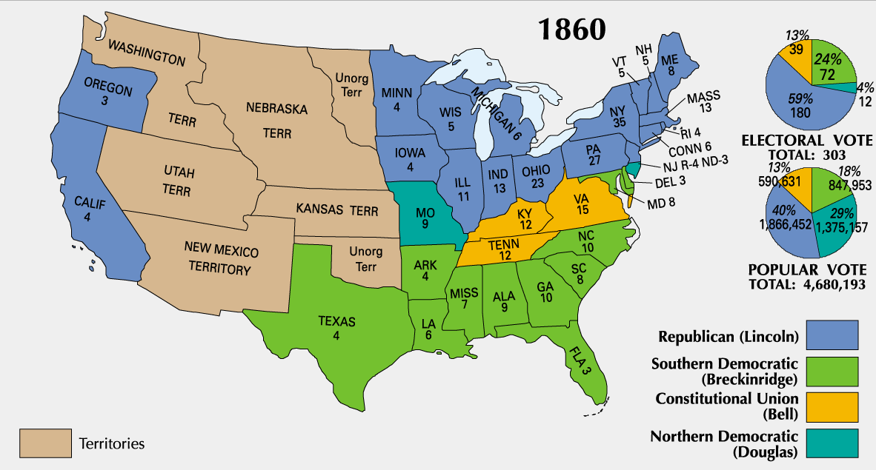
results

Slide 12
III. Election of 1860
A. Abraham Lincoln elected president with only 40% of the popular vote; most sectional election in history
1. Lincoln won all Northern States except for NJ and MO (180 electoral votes to 123)
a. Lincoln not on even on the ballot in 10 southern states
b. South Carolina was not happy with result, reason to secede
2. Breckinridge won all the Deep South states plus Arkansas, Maryland, Delaware
3. Bell won Border States of Virginia, Kentucky and mid-slave state of Tennessee
4. Douglas won only MO and NJ but finished 2nd in popular votes
B. South still had control of both Houses of Congress and a 5-4 majority on Supreme Court

Slide 13
IV. Southern States Secede from Union
A. Southern States leave the Union
1. Four days after the election of Lincoln, the "Black Republican", South Carolina legislature unanimously called for a special convention in Charleston. (Dec 20, 1860 – unanimous vote)
2. Within six weeks, six other states seceded (Mississippi, Florida, Alabama, Georgia, Louisiana, Texas)
a. This all took place during Buchanan’s “lame-duck period”
3. Four other states secede in April 1861 after Lincoln calls for troops (Virginia, Arkansas, North Carolina, Tennessee)
B. Confederate States of America formed in Montgomery, AL
1. Jefferson Davis is chosen as president of the government (later moved to Richmond, Va., after Virginia votes to leave the Union)

Slide 14
C. President Buchanan does little to prevent secession
1. Claimed the Constitution did not give him authority to stop secession with force.
2. Northern army at this point was small, weak and scattered on frontier.
3. Many of his advisors were “pro-southern”
4. Northern sentiment favored peaceful resolution rather than war
5. Buchanan’s wait and see approach probably helped save the Union
a. Use of immediate force would have probably driven border states of Maryland and Kentucky to the South. This would have sealed the Union’s fate.

Slide 15
D. Reasons for Southern Secession
1. Alarmed at the political balance tipping in favor of the North.
2. Horrified at victory of the sectional Republican Party which appeared to threaten their rights as a slaveholding minority. 3. Angry over free-soil criticism and abolitionism, and northern interference such as the Underground Railroad and John Brown’s raid.
4. Many southerners felt secession would be unopposed a. Northern industrialists dependent on southern repayment of loans and cotton could not afford to cut economic ties. b. Debts could be repudiated in case of war. 5. Opportunity to end generations of dependence to the North. a. Independent South could develop its own banking and shipping while trading directly with Europe. b. No longer at the mercy of northern industrialists crying for higher tariffs. 6. Morally they were in the right a. 13 original states had voluntarily entered the Union; now southern states were voluntarily withdrawing from it. b. Saw self-determination of the Declaration of Independence as applying to them.
i. Right to replace gov’t with one that meets the needs of the people

Slide 16
V. Crittenden Amendments (December 18-31, 1860)
A. Proposed by Senator John J. Crittenden of Kentucky (heir to political throne of Clay)
B. Designed to appease the South, give peace one more try
C. Provisions
1. Slavery in the territories was to be prohibited north of 36-30 but was to be given full federal protection south of that line existing or “hereafter to be acquired” (aka Cuba)
2. Popular sovereignty for future states
D. Rejected by Lincoln, all hope of compromise gone
1. Lincoln believed he was elected on the principle of the non-extension of slavery
E. Charleston Courier 1861 editorial: "Men at Washington think there is no chance for peace, and indeed we can see but little, everything looks gloomy. The Crittenden resolutions have been voted down again and again. Is there any other proposition which will win, that the South can accept? If not—there comes war—and woe to the wives and daughters of our land; beauty will be but an incentive to crime, and plunder but pay for John Brown raids. Let our citizens be prepared for the worst, it may come."

Slide 17
VI. Lincoln’s Inauguration and First Days in Office
A. Lincoln’s inaugural address
1. Vowed to preserve the Union, to “hold, occupy and possess” Federal property in the South, “Physically speaking, we cannot separate”
2. Republicans & Democratic unionists agreed with speech’s firmness & moderation
3. Lower South regarded it tantamount to declaration of war.
B. Lincoln’s Cabinet
1. William H. Seward (Secretary of State)
2. Salmon P. Chase (Treasury Secretary)
a. leading abolitionist
b. eventually appointed by Lincoln as Chief Justice of Supreme Court
3. Edwin M. Stanton (Secretary of War)
a. Initially does not support Lincoln’s policies (called Lincoln: “the original gorilla”)
4. Cabinet frequently feuded with each other, adding pressure to Lincoln
C. Lincoln an able leader
1. Developed a genius for interpreting and leading a fickle public opinion.
2. Showed charitableness toward South and patience toward backbiting colleagues.

